Slide 1
第6章 指令流水线
第一讲 流水线数据通路和控制逻辑
第二讲 流水线冒险处理
第三讲 高级流水线技术

Slide 2
第一讲 流水线数据通路和控制
主 要 内 容
日常生活中的流水线处理例子：洗衣服
单周期处理器模型和流水线性能比较
什么样的指令集适合于流水线方式执行
如何设计流水线数据通路-以MIPS指令子集为例
如何设计流水线控制逻辑
分析每条指令执行过程中的控制信号
给出控制器设计过程

Slide 3
复习：A Single Cycle Processor
Branch
<31:26>
RegDst
Jump
Instruction<31:0>
op
Main
Control
ALUSrc
Instruction
Fetch Unit
:
Zero
<0:15>
<21:25>
<11:15>
Clk
<16:20>
ALUop
3
Rd
Rt
Rd
<5:0>
ALU
Control
RegDst
Imm16
1
Mux
0
func
Rs
Rt
3
RegWr
5
5
5
ALUctr
busA
MemWr
MemtoReg
Rw
Ra
Rb
Zero
busW
32
32 32-bit
Registers
ALU
0
32
busB
0
32
Clk
32
Mux
Mux
32
WrEn
Adr
1
1
Data In
32
imm16
Extender
Data
Memory
16
32
Instr<15:0>
Clk
ALUSrc
ExtOp

Slide 4
一个日常生活中的例子—洗衣店工作
Laundry Example
Ann, Brian, Cathy, Dave each have one load of clothes to wash, dry, and fold
Washer takes 30 minutes
Dryer takes 40 minutes
“Folder” takes 20 minutes
A
B
C
D
如果让你来管理洗衣店，你会如何安排？
Pipelining: It’s Natural !

Slide 5
非流水线方式--Sequential Laundry（串行方式）
6 PM
7
8
9
10
11
Midnight
Time
30
40
20
30
40
20
30
40
20
30
40
20
T
a
s
k
O
r
d
e
r
A
B
C
D
串行方式下， 4 批衣服需要花费 6 小时（4x(30+40+20)=360分钟）
N批衣服，需花费的时间为Nx(30+40+20) = 90N
如果用流水线方式洗衣服，则花多少时间呢?

Slide 6
Pipelined Laundry: (Start work ASAP)
6 PM
7
8
9
10
11
Midnight
Time
30
40
40
40
40
20
T
a
s
k
O
r
d
e
r
A
流水线方式用时为 30+4x40+20=210分钟
N批衣服用时：30+Nx40+20
假定每步时间均衡(40)，且N很大(>>2)时流水线方式：40+N40+40≈40N
相对于串行方式 120N 则有：
B
C
120N/40N=3
流水线比串行方式提高约3倍！
D
流水方式下，所用时间主要与最长阶段的时间有关！
下面我们来分析指令在CPU中的执行情况

Slide 7
例如，Load指令分5个阶段：
将一条指令不是简单视为一个周期完成而是分多个阶段
阶段1
阶段2
阶段 3
阶段 4
阶段5
Ifetch
Reg/Dec
Exec
Mem
Wr
Ifetch (取指) : 取指令并计算PC+4 。要用到哪些部件？
Reg/Dec (取数和译码) : 取数同时译码 。要用到哪些部件？
Exec (执行) : 计算内存单元地址。要用到哪些部件？
Mem (读存储器) : 从数据存储器中读。要用到哪些部件？
Wr(写寄存器): 将数据写到寄存器中。要用到哪些部件？
指令存储器、Adder
寄存器组读口、指令译码器
这里寄存器组的读口和写口可看成两个不同的部件。
扩展器、ALU
数据存储器
寄存器组写口
指令序列的执行过程是否和“洗衣店洗衣”过程类似？是否可以采用类似方式来执行指令序列呢？
Notes:
As shown here, each of these five steps will take one clock cycle to complete.
And in pipeline terminology, each step is referred to as one stage of the pipeline.

Slide 8
单周期指令模型与流水模型的性能比较
假定以下每步操作所花时间为：
取指：2ns
寄存器读：1ns
ALU操作：2ns
存储器读：2ns
寄存器写：1ns
单周期模型性能
每条指令在一个时钟周期内完成
时钟周期等于最长的lw指令的执行时间，即：8ns
串行执行时，N条指令的执行时间为：8Nns
若各阶段操作均衡(各阶段都是2ns)则为10Nns
流水线性能
时钟周期等于最长阶段所花时间为：2ns
每条指令的执行时间为： 2nsx5=10ns
N条指令的执行时间为：(N+5-1)x2ns≈2Nns （N很大时）
比串行方式提高约 5倍
Load指令执行时间总计为：8ns
(假定控制单元、PC访问、信号传递等没有延迟)
流水线方式下，单条指令执行时间不能缩短，但能大大提高指令吞吐率！
Notes:
一般情况，对于流水段数为s，N条指令的执行时间=(N+S-1)ꭓ段时长

Slide 9
流水线指令集的设计
具有什么特征的指令集有利于流水线执行呢？
指令长度尽量一致，有利于简化取指令和指令译码操作
MIPS指令32位，下址计算方便: PC+4
X86指令长度从1字节到17字节不等，使取指部件极其复杂
格式少，且源寄存器位置相同，有利于在指令功能未知时就可取操作数
MIPS指令的rs和rt位置一定，在指令译码时就可读rs和rt的值
若位置随指令不同而不同，则需先确定指令类型才能取寄存器编号
load / Store指令才能访问存储器，有利于减少操作步骤，规整流水线。
lw/sw指令的地址计算和运算指令的执行步骤规整在同一个周期
X86运算类指令操作数可为内存数据，需计算地址、访存、执行
内存中“对齐”存放，有利于减少访存次数并使流水线规整。
总之，规整、简单和一致等特性有利于指令的流水线执行。
31
26
21
16
11
6
0
op
rs
rt
rd
shamt
func
6 bits
5 bits
5 bits
5 bits
5 bits
6 bits

Slide 10
由Load指令构成的流水线
Cycle 1
Cycle 2
Cycle 3
Cycle 4
Cycle 5
Cycle 6
Cycle 7
Clock
1st lw
Ifetch
Reg/Dec
Exec
Mem
Wr
2nd lw
Ifetch
Reg/Dec
Exec
Mem
Wr
3rd lw
Ifetch
Reg/Dec
Exec
Mem
Wr
4nd lw
Ifetch
Reg/Dec
Exec
Mem
Wr
5rd lw
Ifetch
Reg/Dec
Exec
Mem
Wr
每个周期有五个功能部件同时在工作
后面指令在前面完成取指后马上开始
虽每个load指令仍然需要五个周期完成，但吞吐率(throughput)提高很多，理想情况下有：
每个周期有一条指令进入流水线
每个周期都有一条指令完成
每条指令的有效周期数(CPI)为1
Notes:
For the load instructions, the five independent functional units in the pipeline datapath are:
(a) Instruction Memory for the Ifetch stage.
(b) Register File’s Read ports for the Reg/Decode stage.
(c) ALU for the Exec stage. (d) Data memory for the Mem stage.
(e) And finally Register File’s write port for the Write Back stage.
Notice that I have treated Register File’s read and write ports as separate functional units because the register file we have allows us to read and write at the same time.
Notice that as soon as the 1st load finishes its Ifetch stage, it no longer needs the Instruction Memory. Consequently, the 2nd load can start using the Instruction Memory (2nd Ifetch).
Furthermore, since each functional unit is only used ONCE per instruction, we will not have any conflict down the pipeline (Exec-Ifet, Mem-Exec, Wr-Mem) either.
I will show you the interaction between instructions in the pipelined datapath later. But for now, I want to point out the performance advantages of pipelining.
If these 3 load instructions are to be executed by the multiple cycle processor, it will take 15 cycles. But with pipelining, it only takes 7 cycles. This (7 cycles), however, is not the best way to look at the performance advantages of pipelining.
A better way to look at this is that we have one instruction enters the pipeline every cycle so we will have one instruction coming out of the pipeline (Wr stages) every cycle.
Consequently, the “effective” (or average) number of cycles per instruction is now ONE even though it takes a total of 5 cycles to complete each instruction.

Slide 11
R-type指令的4个阶段
Cycle 1
Cycle 2
Cycle 3
Cycle 4
R-type
Ifetch
Reg/Dec
Exec
Wr
Ifetch: 取指令并计算PC+4
Reg/Dec: 从寄存器取数，同时指令在译码器进行译码。
Exec: 在ALU中对操作数进行计算
Wr: ALU计算的结果写到寄存器
Notes:
Well, so far so good. Let’s take a look at the R-type instructions.
The R-type instruction does NOT access data memory so it only takes four clock cycles, or in our new pipeline terminology, four stages to complete.
The Ifetch and Reg/Dec stages are identical to the Load instructions. Well they have to be because at this point, we do not know we have a R-type instruction yet.
Instead of calculating the effective address during the Exec stage, the R-type instruction will use the ALU to operate on the register operands.
The result of this ALU operation is written back to the register file during the Wr back stage.

Slide 12
含R-type和 Load 指令的流水线
Cycle 1
Cycle 2
Cycle 3
Cycle 4
Cycle 5
Cycle 6
Cycle 7
Cycle 8
Cycle 9
Clock
R-type
Ifetch
Reg/Dec
Exec
Wr
We have a problem!
R-type
Ifetch
Reg/Dec
Exec
Wr
Load
Ifetch
Reg/Dec
Exec
Mem
Wr
R-type
Ifetch
Reg/Dec
Exec
Wr
R-type
Ifetch
Reg/Dec
Exec
Wr
上述流水线有一个问题----两条指令试图同时写寄存器：
Load在第5阶段用寄存器写口
R-type在第4 阶段用寄存器写口
把一个功能部件同时被多条指令使用的现象称为结构冒险(Struture Hazard)
为了流水线能顺利工作，规定：
每个功能部件每条指令只能用一次（如：寄存器组写口不能用两次或以上）
每个功能部件必须在每条指令相同的阶段被使用（如：寄存器组写口总是在第五阶段被使用）
或称为资源冲突！
Notes:
What happened if we try to pipeline the R-type instructions with the Load instructions?
Well, we have a problem here!!!
We end up having two instructions trying to write to the register file at the same time!
Why do we have this problem (the write “bubble”)?
Well, the reason for this problem is that there is something I forget to tell you.

Slide 13
解决办法：R-type的Wr操作延后一个周期执行
NOOP!
1
2
3
4
5
R-type
Ifetch
Reg/Dec
Exec
Mem
Wr
加一个NOOP阶段以延迟“写”操作:
把“写”操作安排在第5阶段, 这样使R-Type的Mem阶段为空操作NOOP
Clock
Cycle 1
Cycle 2
Cycle 3
Cycle 4
Cycle 5
Cycle 6
Cycle 7
Cycle 8
Cycle 9
R-type
Ifetch
Reg/Dec
Exec
Mem
Wr
R-type
Ifetch
Reg/Dec
Exec
Mem
Wr
Load
Ifetch
Reg/Dec
Exec
Mem
Wr
R-type
Ifetch
Reg/Dec
Exec
Mem
Wr
R-type
Ifetch
Reg/Dec
Exec
Mem
Wr
这样使流水线中的每条指令都有相同的阶段数!
Notes:
Well one thing we can do is to add a “Nop” stage to the R-type instruction pipeline to delay its register file write by one cycle.
Now the R-type instruction ALSO uses the register file’s witer port at its 5th stage so we eliminate the write conflict with the load instruction.
This is a much simpler solution as far as the control logic is concerned. As far as performance is concerned, we also gets back to having one instruction completes per cycle.
This is kind of like promoting socialism: by making each individual R-type instruction takes 5 cycles instead of 4 cycles to finish, our overall performance is actually better off.
The reason for this higher performance is that we end up having a more efficient pipeline.

Slide 14
Store指令的四个阶段
Cycle 1
Cycle 2
Cycle 3
Cycle 4
NOOP!
Store
Ifetch
Reg/Dec
Exec
Mem
Wr
Ifetch：取指令并计算PC+4
Reg/Dec： 从寄存器取数，同时指令在译码器进行译码。
Exec：16位立即数符号扩展后与寄存器值相加，计算主存地址。
Mem：将寄存器读出的数据写到主存
Wr: 加一个空的写阶段，使流水线规整统一！
Notes:
Let’s continue our lecture by looking at the store instruction.
Once again, the Ifetch and Reg/Decode stages are the same as all other instructions.
The Exec stage of the store instruction calculates the memory address.
Once the address is calculated, the store instruction will write the data it read from the register file back at the Reg/Decode stage into the data memory during the Mem stage.
Notice that unlike the load instruction which takes five cycles to accomplish its task, the Store instruction only takes four cycles or four pipe stages.
In order to keep our pipeline diagram looks more uniform, however, we will keep the Wr stage for the store instruction in the pipeline diagram.
But keep in mind that as far as the pipelined control and pipelined datapath are concerned, the store instruction requires NOTHING to be done once it finishes its Mem stage.

Slide 15
Beq的四个阶段
Cycle 1
Cycle 2
Cycle 3
Cycle 4
NOOP!
Beq
Ifetch
Reg/Dec
Exec
Mem
Wr
Ifetch: 取指令并计算PC+4
Reg/Dec:从寄存器取数，同时指令在译码器进行译码
Exec: 执行阶段
ALU中比较两个寄存器的大小（做减法）
Adder中计算转移地址
Mem: 如果比较相等, 则：
转移目标地址送到PC的输入端，该阶段结束时写入PC。
Wr: 加一个空阶段，使流水线更规整！
按照上述方式，把所有指令都按照最复杂的“load”指令所需的五个阶段来划分，不需要的阶段加一个“NOOP”空操作。
Notes:
Well similar to the store instruction, the branch instruction only consists of four pipe stages.
Ifetch and Reg/decode are the same as all other instructions because we do not know what instruction we have at this point. We have not finish decoding the instruction yet.
During the Execute stage of the pipeline, the BEQ instruction will use the ALU to compare the two register operands it fetched during the Reg/Dec stage.
At the same time, a separate adder is used to calculate the branch target address.
This is difference from M-cycle processor where target address is calculated by ALU but at the 2nd cycle.
If the registers we compared during the Execute stage (point to the last bullet) have the same value, the branch is taken.
That is, the branch target address we calculated earlier (last bullet) will be written into the Program Counter.
Once again, similar to the Store instruction, the BEQ instruction will require NEITHER the pipelined control nor the pipelined datapath to do ANY thing once it finishes its Mem stage.
With all these talk about pipelined datapath and pipelined control, let’s take a look at how the pipelined datapath looks like.

Slide 16
A Pipelined Datapath（五阶段流水线数据通路）
Clk
Ifetch (IF)
Reg/Dec (ID)
Exec (Ex)
Mem
Wr
有！寄存器写口
RegWr
ExtOp
ALUOp
Branch
1
0
Wr阶段没有DataPath吗？
PC+4
PC+4
PC
PC+4
Imm
Imm
Rs
busA
Zero
Data
Mem
A
Ra
busB
IUnit
Rb
Exec
Unit
RA
Do
IF/ID Register
ID/Ex Register
Ex/Mem Register
Mem/Wr Register
Rt
1
RFile
WA
Mux
Rw
Di
Di
Rt
0
0
I
增加了流水段寄存器，作用是什么？
Rd
1
RegDst
ALUSrc
MemWr
MemtoReg
保存每个周期执行的结果! 它们属于内部寄存器，对程序员透明。
下面看每条指令在流水线通路中的执行过程
Notes:
The pipelined datapath consists of combination logic blocks separated by pipeline registers. If you get rid of all these registers (not the PC), this pipelined datapath is reduced to the single-cycle datapath.
This should give you extra incentive to do a good job on your single cycle processor design homework because you can build your pipeline design based on your single cycle design.
Anyway, the registers mark the beginning and the end of a pipe stage.
In the multiple clock cycle lecture, I recommended that the best way to think about a logic clock cycle is that it begins slightly after the clock tick and ends right at the next clock tick.
For example here, the Reg/Decode stage begins slightly after this clock tick when the output of the IF/ID register has stabilized to its new value AND ends RIGHT at the next clock tick when the output of the register file is clocked into the ID/Exec register.
At the end of the Reg/Decode stage, the register output that just clocked into the ID/Exec register has NOT yet propagate to the register output yet. It takes a Clk-to-Q delay.
When the new value we just clocked in (points to the clock tick) has propagate to the register output, then we have reach the beginning of the Exec stage.
Notice that the Wr stage of the pipeline starts here (last cycle) but there is no corresponding datapath underneath it because the Wr stage of the pipeline is handled by the same part of the pipeline that handles the Register Read stage.
This part of the datapath (Reg File) is the only part that is used by more than one stage of the pipeline. This is OK because the register file has independent Read and Write ports.
More specifically, the Reg/Decode stage of the pipeline uses the register file’s read port while the Write Back stage of the pipeline uses the register file’s write port.

Slide 17
取指令（Ifetch) 阶段
这里的假设有没有问题呢？
MIPS指令的地址可以是10吗？
NO!
12
设第 10 单元存有指令: lw $1, 0x100($2) 功能：$1 ← Mem [($2) + 0x100]
You are here!
Clk
Ifetch
Reg/Dec
Exec
Mem
Wr
RegWr
ExtOp
ALUOp
Branch
1
0
PC+4
PC+4
PC+4
Imm
Imm
PC = 12
Rs
busA
Zero
Data
Mem
A
Ra
busB
IF/ID: lw $1, 100 ($2)
Exec
Unit
RA
Do
IUnit
Rb
ID/Ex Register
Ex/Mem Register
Mem/Wr Register
Rt
1
RFile
WA
Mux
Rw
Di
Di
I
Rt
0
0
Rd
1
下一目标：设计IUnit（功能是啥？）
RegDst
ALUSrc
MemWr
MemtoReg
先考虑一下IUnit中有哪些功能部件？
Notes:
Let’s follow a Load instruction down the pipeline and see how everything works.
Every instruction starts at the Instruction Fetch stage which:
(a) Begins slightly after the first clock tick when PC output has stabilized to its new value.
(b) And ends when the output of the I-Unit is clocked into the IF/ID register.
This picture shows the state of the pipeline at the end of the Ifetch stage (you are here).
Let’s expand this part of the datapath and take a better look.

Slide 18
指令部件 IUnit的设计
第12单元指令: lw $1, 0x100($2) 随后的指令在16号单元中！
指令部件功能
You are here!
Instr ← M[PC]
PC← PC+4
Clk
Ifetch
Reg/Dec
开始从16号单元取指！
1
0
这里MUX的控制信号由其他阶段产生！其初值固定为0
“4”
Adder
PC = 12
12
流水段寄存器用来存放各阶段的执行结果
IF/ID: lw $1, 100 ($2)
Address
应把哪些信息存到流水段寄存器IF/ID中？
PC 新值（16） ≠旧输出（12）
Instruction
Memory
Instruction
应保存后面阶段用到的指令和PC+4的值！
取指阶段有哪些控制信号？
不需控制信号，因为每条指令执行功能一样，是确定的，无需根据指令的不同来控制执行不同的操作！
指令在随后阶段被送出译码，
PC+4用来计算转移目标地址
IF/ID寄存器有多少位？
32+32
Notes:
Let’s assume the Load instruction we are following is in memory location TEN, 10.
So the Ifetch stage begins shortly after the first clock tick when the value 10 appears on the Program Counter register output.
This is used as the address to access the Instruction Memory and at the same time it is fed to the adder so it can be increment by four.
At the end of the Ifetch stage, this clock tick will clock the output of the instruction memory, which is the Load instruction, into the If/ID pipeline register.
As the same time, the PC plus 4 value, that is 14 in this case, will be clocked into the PC.
Notice that the picture here shows the stage of the pipeline at the END of the Ifetch stage (you are here) so the number 14, even though is already latched into the register, will not appear at the PC output until Clk-to-Q time later.
Similarly, the load instruction we just clocked into the IF/ID register will NOT appear at the register output until a Clk-toQ delay after this clock.
And when it appears at the IF/iD register output, we will be in the Reg/Decode stage.

Slide 19
译码/取数（Reg/Dec）阶段
Location 12: lw $1, 0x100($2) 功能：$1 <- Mem[($2) + 0x100]
You are here!
Clk
Ifetch
Reg/Dec
Exec
Mem
Wr
RegWr
ExtOp
ALUOp
Branch
1
RegWr是Wr段的信号
0
PC+4
PC+4
PC
PC+4
IF/ID:
Imm
Imm
Rs
busA
Zero
Data
Mem
A
Ra
busB
ID/Ex: Reg. 2 & 0x100
IUnit
Rb
Exec
Unit
RA
Do
Ex/Mem Register
Mem/Wr Register
指令还要存ID/EX中吗？
不要，只要存相关信息:
Rt
1
RFile
WA
Mux
Rt
Rw
Di
Di
I
0
0
Rd
1
R[Rs],R[Rt],Rt,Rd,Imm16,PC+4等被保存在ID/EXE中
RegDst
ALUSrc
MemWr
MemtoReg
该阶段有哪些控制信号？
没有！因是所有指令的公共操作，故无控制信号！
Notes:
This picture shows the state of the pipeline at the end of Load’s Reg/Decode stage.
All the datapath has to do is read register (Ra and busA) R2 from the register file.
As the same time, we need to pass the Immediate field of the instruction onto the next stage (ID/Exec) register because the immediate field is needed for address calculation.
Let’s concentrate on the load instruction (point to the 1st bullet) going down the pipe and ignore what is in the PC and IF/ID registers for now.
Since we are here (Your are Here), Register R2 and Imm16 have already clocked into ID/Exec register but they have not yet appeared at the register’s output.

Slide 20
Load指令的地址计算（Exec）阶段
Location 12: lw $1, 0x100($2) 功能：$1 <- Mem[($2) + 0x100]
指令已被译码，可确定执行部件的控制信号！
You are here!
Clk
Ifetch
Reg/Dec
Exec
Mem
ALUOp=？
RegWr
ExtOp=？
Branch
1
0
PC+4
PC+4
PC
PC+4
IF/ID:
Imm
Imm
Rs
busA
Zero
Zero
Data
Mem
A
Ra
busB
Rb
Exec
Unit
RA
IUnit
Ex/Mem: Load’s Address
Do
ID/Ex Register
Mem/Wr Register
Rt
1
RFile
WA
Mux
Rt
Rw
Di
Di
I
0
Rt
0
Rd
1
目的寄存器Rt不传递下去会怎样？
连接到错误的目的地址，指令执行错误！
RegDst=0
ALUSrc=？
MemWr
MemtoReg
下一目标：设计执行部件(Exec Unit)
应该有哪些部件？
Notes:
If we wait a little bit longer (beginning of Exe), Register R2 and Imm16 will appear at the ID/Exec register output and we are now in the Exec stage where we will calculate the Memory Address for the load instruction.
Notice that besides calculating the Load’s Memory Address, we also need to pass the Rt field (RegDst = 0) of the instruction down the pipeline.
The reason is that we will need to use Rt field later on to specify which register to write to when we reach the end of the Load pipeline.
Also notice that this is the first stage of the pipeline that requires any control signals.
We will talk more about this (Rt field and other control signals) later but for now, let’s expand this part of the datapath and take a closer look at what is going on.

Slide 21
执行部件（Exec Unit）的设计
执行部件功能？
计算内存地址
计算转移目标地址
一般ALU运算
You are here!
Clk
Exec
Mem
Adder用于计算分支指令的转移地址
Load指令的各控制信号取值？
<< 2
Target
RegDst=0, ALUSrc=1 ALUOp=addu, ExtOp=1
Adder
32
PC+4
R-Type=0
busA
32
Store指令呢？
Zero
RegDst=x, ALUSrc=1 ALUOp=addu, ExtOp=1
ID/Ex Register
32
Ex/Mem: Load’s Memory Address
busB
ALU
ALUout
R-Type=0
0
32
Branch指令呢？
32
Mux
3
ALUctr
RegDst=x, ALUSrc=0 ALUOp=subu, ExtOp=1
imm
1
0
Extender
1
3
R-Type=0
16
32
ALU
Ori指令呢？
Control
R-Type=?
RegDst=0, ALUSrc=1 ALUOp=or, ExtOp=0
ExtOp=?
ALUSrc=?
ALUOp=?
R型指令呢？
func
R-Type=0
RegDst=1, ALUSrc=0 ALUctr=‘func’, ExtOp=x
R-Type=1
Notes:
At the beginning of the Exec cycle, ID/Exec register’s output will be stabilized to Register R2 (bus A) and Imm16.
By setting the control signals ExtOp and ALUSrc to 1s, the 16-bit immediate field will be sign extended to 32 bits and pass onto the ALU.
The ALU then add (ALUOp = Add) this sign extended version of the Immediate field to Register 2 (busA) to form the memory address.
By the end of the Exec cycle (you are here), the ALU output will be valid and will be stored into the Exec/Mem pipeline register.
This Memory Address (Exec/Mem) will appear at the output of the Exec/Mem register a Clk-to-Q time after this clock tick (you are here).

Slide 22
Load指令的存储器读(Mem)阶段
Location 12: lw $1, 0x100($2) 功能： $1 <- Mem[($2) + 0x100]
You are here!
Clk
Ifetch
Reg/Dec
Exec
Mem
Wr
RegWr
ExtOp
ALUOp
Branch=0
1
0
PC+4
PC+4
PC
PC+4
IF/ID:
Imm
Imm
Rs
busA
Zero
Data
Mem
A
Ra
busB
Rb
Exec
Unit
RA
Do
IUnit
ID/Ex Register
Ex/Mem Register
Mem/Wr: Load’s Data
Rt
1
RFile
WA
Mux
Rw
Di
Di
Rt
0
0
I
比较洗衣流水线，指令流水线有什么不同?
Rd
1
洗衣流程不能反向进行，但
RegDst
ALUSrc
MemWr=0
MemtoReg
该阶段有反向数据流，可能会引起冒险！
周期以最长操作为准设计：Cycle > T_{read}存储器读数时间
Notes:
And it will be used to read the Data Memory (RA).
By setting the clock cycle time longer than the data memory read access time, we can guarantee the memory output (Do) will be stable by the end of the Mem cycle (you are here).
And this clock tick will trigger the Mem/Wr register to latch in Load’s data.
We have to pass the Load instruction’s Rt field down the pipeline one more time because we still have not use it yet.

Slide 23
Load指令的回写（Write Back）阶段
Location 12: lw $1, 0x100($2) 功能：$1 <- Mem[($2) + 0x100]
Clk
Ifetch
Reg/Dec
Exec
Mem
Wr
RegWr=1
ExtOp
ALUOp
Branch
1
0
PC+4
PC+4
PC
PC+4
IF/ID:
Imm
Imm
Rs
busA
Zero
Data
Mem
A
Ra
busB
IUnit
Rb
Exec
Unit
RA
Do
ID/Ex Register
Ex/Mem Register
Mem/Wr Register
Rt
1
RFile
WA
Mux
Rw
Di
Di
Rt
0
0
I
Rd
1
该阶段所需控制信号：
MemtoReg=1
RegWr=1
RegDst
ALUSrc
MemWr
MemtoReg=1
该阶段有反向数据流，可能会引起冒险！
各阶段所经DataPath已有，控制信号如何得到？
Notes:
The Rt filed of the load instruction will be used in the Register Write back stage of the pipeline (Wr) to specified the register (Rw) where the load data is written.
Since we are writing the load’s data into the register file, the control signal MemtoReg and RegWr must be set to 1.
So this finishes the grand tour of how a load instruction flows through the datapath.
But how about control signals?

Slide 24
流水线中的Control Signals如何获得?
主要考察: 第N阶段的控制信号，它取决于某条指令的某个阶段。
N = Exec, Mem, Wr (只有这三个阶段有控制信号）
例: Load的Exec段的控制信号 = Func (Load’s Exec)
Ifetch
Reg/Dec
Exec
Mem
Wr
ALUOp=Add
RegWr
ExtOp=1
Branch
1
0
PC+4
PC+4
PC+4
IF/ID:
Imm
Imm
PC
Rs
busA
Zero
Data
Mem
A
Ra
busB
Rb
Exec
Unit
RA
Do
IUnit
ID/Ex Register
Ex/Mem: Load’s Address
Mem/Wr Register
Rt
1
RFile
WA
Mux
Rw
Di
Di
Rt
0
0
I
Rd
1
为什么 1st 和 2nd 阶段没有控制信号?
ALUSrc=1
RegDst=0
MemWr
MemtoReg
IF和ID阶段的功能对每条指令来说都一样
Notes:
The key observation about the control signals is that the control signals at Stage N depends ONLY on the instruction that is currently in Stage N, where N is either Exec, Mem, or Wr (points to the control signals at each stage, especially RegWr at Wr stage).
Notice that I did not mention anything about the Ifet and Dec stage because there cannot be any instruction dependent control signals at these two stages. Why?
Because at these two stages (Ifetch and Dec) we do not know what instructions we have yet: we have just fetch the instruction (Ifetch) and is still in the process of decoding it (Dec).
Here is an example of this rule (1st bullet). During the Load instruction’s Exec stage, the control signals (ExtOp, ALUSrc, ALUOp) in the Exec stage are set this way because this is the setting required to do the right things for Load instruction's Exec stage.
Since the control signals depend ONLY on the instruction that is currently in that stage of the pipeline (1st Bullet), the control is very similar to the Controller for the single cycle processor.
The difference is that after we generate the control signals, we need to pipeline them so they are applied to the correct stage of the pipeline (Exec, Mem, an Wr) when the instruction reaches that stage.
Let me show you what I mean by this.

Slide 25
Load指令:流水线中的控制信号
在取数/译码（Reg/Dec）阶段产生本指令每个阶段的所有控制信号
Exec的控制信号 (ExtOp, ALUSrc, …) 在1个周期后使用
Mem的控制信号 (MemWr, Branch) 在2个周期后使用
Wr的控制信号 (MemtoReg, RegWr) 在3个周期后使用
所以，控制信号也要保存在流水段寄存器中！
Reg/Dec
Exec
Mem
Wr
ExtOp
ExtOp
ALUSrc
ALUSrc
ALUOp
ALUOp
Main
Control
RegDst
RegDst
R_type
R_type
Ex/Mem Register
IF/ID Register
ID/Ex Register
MemWr
Mem/Wr Register
MemWr
MemWr
Branch
Branch
Branch
MemtoReg
MemtoReg
MemtoReg
MemtoReg
RegWr
RegWr
RegWr
RegWr
各流水段部件在一个时钟内完成某条指令的某个阶段的工作！
在下个时钟到达时，把执行结果以及前面传递来的后面各阶段要用到的所有数据（如：指令中的立即数、目的寄存器等）和控制信号保存到流水段寄存器中！
Notes:
The main control here is identical to the one in the single cycle processor. It generate all the control
signals necessary for a given instruction during that instruction’s Reg/Decode stage.
All these control signals will be saved in the ID/Exec pipeline register at the end of the Reg/Decode cycle.
The control signals for the Exec stage (ALUSrc, ... etc.) come from the output of the ID/Exec register. That is they are delayed ONE cycle from the cycle they are generated.
The rest of the control signals that are not used during the Exec stage is passed down the pipeline and saved in the Exec/Mem register.
The control signals for the Mem stage (MemWr, Branch) come from the output of the Exec/Mem register. That is they are delayed two cycles from the cycle they are generated.
Finally, the control signals for the Wr stage (MemtoReg & RegWr) come from the output of the Exec/Wr register: they are delayed three cycles from the cycle they are generated.

Slide 26
流水线中的Control Signals
通过对前面流水线数据通路的分析，得知：
PC需要写使能吗？
流水段寄存器需要写使能吗？
Ifecth阶段和Reg/Dec阶段都没有控制信号
Exec阶段的控制信号有五个
ExtOp (扩展器操作)：1- 符号扩展；0- 零扩展
ALUSrc (ALU的B口来源)：1- 来源于扩展器；0- 来源于BusB
ALUOp (主控制器输出，与局部ALUControl控制逻辑一起决定ALUCtrl)
RegDst (指定目的寄存器)：1- Rd；0- Rt
R_type (是否为R型指令) ：选择控制信号ALUCtrl ,1-R型指令; 0-非R型指令
Mem阶段的控制信号有两个
MemWr (DM的写信号)：Store指令时为1，其他指令为0
Branch (是否为分支指令)：分支指令时为1，其他指令为0
Wr阶段的控制信号有两个
MemtoReg (寄存器的写入源)：1- DM输出；0- ALU输出
RegWr (寄存器组写信号)：结果写寄存器的指令都为1，其他指令为0
每个时钟都会改变PC，故不需要!
每个时钟都会改变流水段寄存器，故不需要!
Notes:
The key observation about the control signals is that the control signals at Stage N depends ONLY on the instruction that is currently in Stage N, where N is either Exec, Mem, or Wr (points to the control signals at each stage, especially RegWr at Wr stage).
Notice that I did not mention anything about the Ifet and Dec stage because there cannot be any instruction dependent control signals at these two stages. Why?
Because at these two stages (Ifetch and Dec) we do not know what instructions we have yet: we have just fetch the instruction (Ifetch) and is still in the process of decoding it (Dec).
Here is an example of this rule (1st bullet). During the Load instruction’s Exec stage, the control signals (ExtOp, ALUSrc, ALUOp) in the Exec stage are set this way because this is the setting required to do the right things for Load instruction's Exec stage.
Since the control signals depend ONLY on the instruction that is currently in that stage of the pipeline (1st Bullet), the control is very similar to the Controller for the single cycle processor.
The difference is that after we generate the control signals, we need to pipeline them so they are applied to the correct stage of the pipeline (Exec, Mem, an Wr) when the instruction reaches that stage.
Let me show you what I mean by this.

Slide 27
流水线控制逻辑(Control)的设计
每条指令的控制信号在该指令的Reg/Dec阶段产生后就不改变，并向后面的流水段寄存器依次移动。
与单周期的控制逻辑设计类似
设计过程
控制逻辑分成两部分
主控制逻辑：生成ALUOp和其他控制信号
局部ALU控制逻辑：根据ALUOp和func字段生成ALUCtrl
用真值表建立指令和控制信号之间的关系
写出每个控制信号的逻辑表达式
控制逻辑的输出（控制信号）在Reg/Dec阶段生成，并存放在ID/EX流水段寄存器中，然后每来一个时钟把后面段需要的控制信号传送到下一级流水段寄存器。
某时刻在不同阶段同时执行不同指令，不同的指令得到不同控制信号

Slide 28
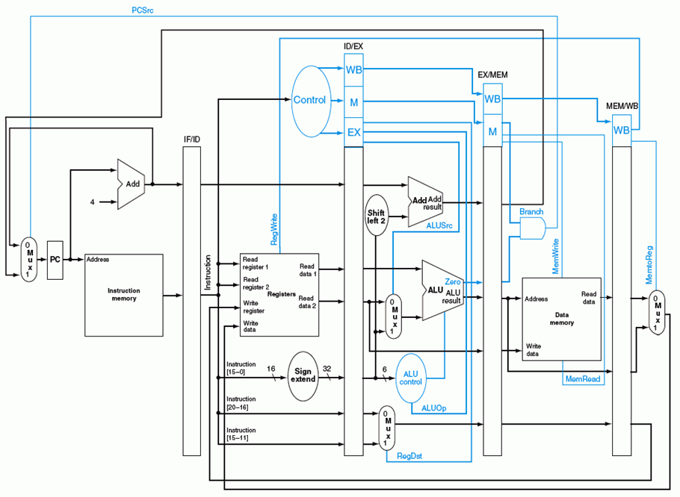
蓝色部分是控制信号

Slide 29
第二讲 流水线冒险处理
主 要 内 容
结构冒险及其处理方法
数据冒险及其处理方法
控制冒险及其处理方法

Slide 30
流水线冒险（hazard）
在指令流水线中，当遇到某些情况使得流水线无法正确执行后续指令，而引起流水线阻塞或停顿，这个现象称为流水线冒险。
根据引起冒险的原因不同，分为结构冒险、数据冒险和控制冒险三种。
结构冒险
现象：一个部件同时被不同指令所用，即在使用硬件资源时发生了冲突。
时钟周期
Load
Mem
Reg
ALU
Mem
Reg
指令序列
Instr 1
Mem
Reg
ALU
Mem
Reg
Instr 2
Mem
Reg
ALU
Mem
Reg
Instr 3
Mem
Reg
ALU
Mem
Reg
Instr 4
Mem
Reg
ALU
Mem
Reg

Slide 31
结构冒险的解决方法
为了避免结构冒险，规定流水线数据通路中功能部件的设置原则为：
每个部件安排在特定的阶段使用！ 如：ALU总在指令的第三阶段使用
将Instruction Memory (Im) 和 Data Memory (Dm)分开
将寄存器读口和写口独立开来
时钟周期
Load
Im
Reg
ALU
Dm
Reg
Instr 1
Im
Reg
ALU
Dm
Reg
指令序列
Instr 2
Im
Reg
ALU
Dm
Reg
Instr 3
Im
Reg
ALU
Dm
Reg
Instr 4
Im
Reg
ALU
Dm
Reg

Slide 32
数据冒险（ Data Hazard ）
现象：后面指令用到前面指令结果时，前面指令的结果还没产生。
时钟周期
例如：
IF
ID
Ex
Mem
Wr
add r1,r2,r3
Im
Reg
ALU
Dm
Reg
指令序列
sub r4,r1,r3
Im
Reg
ALU
Dm
Reg
and r6,r1,r7
Im
Reg
ALU
Dm
Reg
or r8,r1,r9
Im
Reg
ALU
Dm
Reg
xor r10,r1,r11
Im
Reg
ALU
Dm
Reg
第1条指令的目的操作数是r1，它是后面几条指令的源操作数。
第1条指令要到Wr阶段才写入r1，但后面的指令sub和and在此之前就读r1，or指令在Wr同时读r1，显然会得出错误的结果。

Slide 33
数据冒险的解决方法
方法1：硬件阻塞（stall）
方法2：软件插入“NOP”指令
方法3：合理实现寄存器组的读/写操作
方法4：转发（Forwarding或Bypassing 旁路）技术
方法5：编译优化--调整指令顺序（不能解决所有数据冒险）

Slide 34
方法1: 在硬件上采取措施，使相关指令延迟执行
硬件上通过阻塞(stall)方式阻止后续指令执行，延迟到有新值以后！
这种做法称为流水线阻塞，也称为插入“气泡(Bubble)”
Time (clock cycles)
IF
ID
Ex
Mem
Wr
add r1,r2,r3
Im
Reg
ALU
Dm
Reg
I
n
s
t
r.
O
r
d
e
r
stall
Im
bubble
bubble
bubble
bubble
stall
Im
bubble
bubble
bubble
bubble
stall
Im
bubble
bubble
bubble
bubble
sub r4,r1,r3
Im
Reg
Dm
Reg
ALU
and r6,r1,r7
Im
Reg
Dm
ALU
缺点：控制比较复杂，需要改数据通路；指令被延迟三个时钟执行。

Slide 35
方法 2: 软件上插入空操作指令
由编译器插入三条NOP指令，浪费三条指令的空间和时间，是最差的做法。
好处：数据通路简单，即无需改数据通路。
Time (clock cycles)
IF
ID
EX
Mem
Wr
add r1,r2,r3
Im
Reg
ALU
Dm
Reg
I
n
s
t
r.
O
r
d
e
r
nop
Im
Reg
ALU
Dm
Reg
nop
Im
Reg
ALU
Dm
Reg
nop
Im
Reg
ALU
Dm
Reg
sub r4,r1,r3
Im
Reg
Dm
Reg
ALU
and r6,r1,r7
Im
Reg
ALU
Dm
与方案1比，哪个更快？
一样，都是延迟三个时钟周期！

Slide 36
方法3: 同一周期内寄存器组先写后读
寄存器组的读口和写口是相互独立的部件！前半时钟周期写，后半时钟周期读
若同一个时钟内前面指令写入的数据正好是后面指令所读数据，就不会发生数据冒险。
例如：
Time (clock cycles)
IF
ID/RF
EX
MEM
WB
add r1,r2,r3
Im
Reg
ALU
Dm
Reg
I
n
s
t
r.
O
r
d
e
r
sub r4,r1,r3
Im
Reg
ALU
Dm
Reg
and r6,r1,r7
Im
Reg
ALU
Dm
Reg
or r8,r1,r9
Im
Reg
ALU
Dm
Reg
xor r10,r1,r11
Im
Reg
ALU
Dm
Reg
例子中add指令与or指令的冲突解决了，但与sub和and指令没有解决。
只能解决部分数据冒险！

Slide 37
方法4: 利用DataPath中的中间数据：转发+阻塞
Time (clock cycles)
IF
ID
Ex
Mem
Wr
add r1,r2,r3
Im
Reg
ALU
Dm
Reg
I
n
s
t
r.
O
r
d
e
r
sub r4,r1,r3
Im
Reg
ALU
Dm
Reg
and r6,r1,r7
Im
Reg
ALU
Dm
Reg
or r8,r1,r9
Im
Reg
ALU
Dm
Reg
xor r10,r1,r11
Im
Reg
ALU
Dm
Reg
仔细观察后发现：流水段寄存器中早已有需要的值r1！
在哪个流水段R中？
把数据从流水段寄存器中直接取到ALU的输入端,称为转发或旁路（Bypassing）
这种方法需要在硬件上增加相应的逻辑电路和控制信号，如在ALU输入端增加多路转换器，检测转发条件是否满足的转发检测单元等。

Slide 38
Load-use数据冒险
若指令的源数据是上一条指令从DM读出内容
Time (clock cycles)
IF
ID
Ex
Mem
Wr
lw r1,r2,imm
Im
Reg
ALU
Dm
Reg
sub r4,r1,r3
Im
Reg
ALU
Dm
Reg
这种数据冒险能转发吗？
不能，因为它从DM中读出送入段寄存器前，后条指令就要在ALU中用。
因此，后条指令需被阻塞一个时钟 或 加一条NOP指令。
这种数据冒险称为Load-use数据冒险

Slide 39


方法5：用编译器调整指令顺序来解决数据冒险
实现“转发”和“阻塞” 要修改数据通路：
检测何时需要“转发”或 “阻塞”，并控制实现“转发”或“阻塞”。
如果硬件不支持转发和阻塞处理，或对于Load-use冒险，则编译器可调整指令顺序或插入NOP指令。
例如，以下源程序可生成两种不同的代码，优化的代码可避免Load-use阻塞
a = b + c;
d = e – f;
假定 a, b, c, d ,e, f 在内存
Fast code:
lw $2, b
lw $3, c
lw $5, e
add $1, $2, $3
lw $6, f
sw $1, a
sub $4, $5, $6
sw $4, d
Slow code:
lw $2, b
lw $3, c
add $1, $2, $3
sw $1, a
lw $5, e
lw $6, f
sub $4, $5, $6
sw $4, d
Load-use
数据冒险
调整后
编译器的优化很重要！

Slide 40
控制冒险（ Control Hazard ）
现象：当遇到改变指令执行顺序的转移指令(分支、跳转、调用、返回等)、异常和中断等情形时，在形成转移目的地址之前，流水线中已取了后续指令并在执行，这时就需要清除流水线中的部分指令的执行。
Cycle 4
Cycle 5
Cycle 6
Cycle 7
Cycle 8
Cycle 9
Cycle 10
Cycle 11
Clk
IF
12: Beq
(target is 1000)
ID
Ex
Mem
Wr
16: R-type
Ifetch
Reg/Dec
Exec
Mem
Wr
BACK
20: R-type
Ifetch
Reg/Dec
Exec
Mem
Wr
例如,Beq指令转移地址为1000。
24: R-type
Ifetch
Reg/Dec
Exec
Mem
Wr
1000: Target of Br
Ifetch
Reg/Dec
Exec
Mem
Wr
Beq指令在Cycel 4取出，但要在Mem阶段(Cycel7)才确定“是否转移”，即在第7周期目标地址才被送到PC输入端，第8周期才取出目标地址处的指令执行。
结果：在取1000号单元的目标指令之前，已有三条指令被取出，取错了三条指令！
发生转移时，要在流水线中清除Beq后面的三条指令，分别在Exec 、Reg/Dec、 Ifetch段中。这样就会产生延迟。
延迟损失时间片C：发生转移时，给流水线带来的延迟损失
这里 C=3

Slide 41
控制冒险的解决方法
方法1：硬件上阻塞（stall）分支指令后三条指令的执行
使后面三条指令清0或 其操作信号清0，即插入三个气泡。
方法2：软件上插入三条“NOP”指令
（以上两种方法的效率太低，需结合分支预测进行）
方法3：分支预测（Predict）
简单（静态）预测：
总是预测条件不满足(not taken)，即：继续执行分支指令的后续指令。
动态预测：
根据程序执行的历史情况进行动态预测调整，能达90%的预测准确率。
方法4：延迟分支（Delayed branch）（通过编译程序优化指令顺序！）
把分支指令前面与分支指令无关的指令调到分支指令后执行，也称延迟转移

Slide 42
简单（静态）分支预测方法
基本方法
总是预测条件不满足(not taken)，即：继续执行分支指令的后续指令
预测失败时，需把流水线中三条错误预测指令丢弃掉
将被丢弃指令的控制信号值或指令设置为0
（注：涉及到当时在IF、ID和EX三个阶段的指令）
性能
如果转移概率是50%，则预测正确率仅有50%。
可以加启发式规则：在特定情况下总是预测满足(taken)，其他情况总是预测不满足。
例如,循环顶部分支总是预测为不满足，而循环底部分支总是预测为满足，则能达65%-85%的预测准确率。
预测错误的代价
预测错误的代价与何时能确定是否转移有关。越早确定代价越少。
是否可把判断转移的工作提前，而不等到MEM阶段才确定？
可以！
那么，最早可以提前到哪个阶段呢？

Slide 43
缩短分支延迟，减少错误预测代价
可以将 “转移地址计算”和“分支条件判断”操作调整到ID阶段来缩短延迟
将转移地址生成从MEM阶段移到ID阶段，可以吗？为什么？
可以。因为IF/ID流水段寄存器中已经有PC的值和立即数。
将“判0”操作从EX阶段移到ID阶段，可以吗？为什么？
可以。用逻辑运算(如，先按位异或，再结果各位相或)来直接比较Rs和Rt的值。
简单判断用逻辑运算，复杂判断可以用专门指令提前生成条件码。
许多条件判断都很简单。
预测错误的检测和处理
当Branch=1并且Zero=1时，发生转移（taken）。
增加控制信号：IF.Flush=Branch and Zero，取值为1时，说明预测失败。
预测失败 (条件满足) 时，完成以下两件事：
将转移目标地址->PC
清除IF段中取出的指令，即：将IF/ID中的指令字清0，转变为nop指令
这种清除操作称为“冲刷或冲洗” -- Flush
原来要清除三条指令，调整后只需要清除一条指令，因而只延迟一个时钟周期，每次预测错误减少了两个周期的代价！
即：这里 C=1

Slide 44
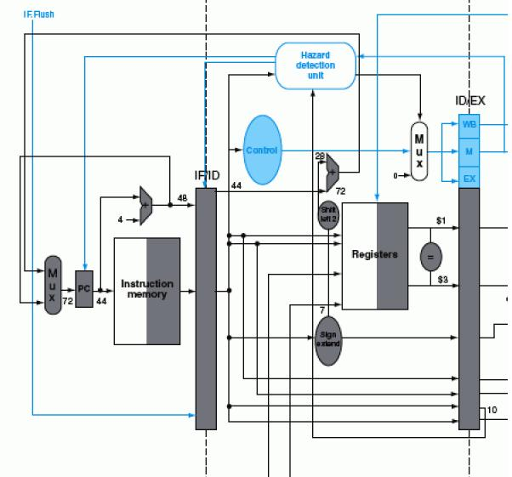
带静态分支预测处理的数据通路
sub $3, $5, $1 add $1, $5, $2
beq $1, $3, 7
生成 IF.Flush=Branch and Zero
40#指令“beq $1,$3,7” ID段
转移目址(72)->PC
$1=$3?
72
①
控制转移
目址->PC
②
冲刷控制
使IF/ID中指令字清0，变为nop指令
若$1或$3和前面指令数据相关，会怎么样？
上上条指令的EXE段结果可转发回来进行判断
上条指令的EXE段结果来不及转发回来，引起1次阻塞!
需重新改“转发”条件和转发线路！

Slide 45
动态分支预测方法
简单的静态分支预测方法的预测成功率不高，应考虑动态预测。
动态预测基本思想：
利用最近转移发生的情况，来预测下一次可能转移还是不转移。
根据实际情况动态调整预测
转移发生的历史情况记录在分支历史记录表BHT（Branch History Table）中
有的系统中将这个表叫做分支预测缓冲BPB（Branch Prediction Buffer）
BHT的每个表项由分支指令地址低位作索引

Slide 46
分支历史记录表BHT
分支指令地址
分支历史记录表BHT
最初BHT为空
=？
分支指令地址
预测位
转移目标地址
①
查找
转移取
顺序取
查找时发现都不相等，则“未命中”
未命中说明什么？
指令预取器
⑤ 修正
②
预测
说明以前没有执行过该分支指令
④加入新项
③
选择
控制逻辑
指令执行
命中与否
实际执行情况
未命中时：
在BHT中加入新项，并填入指令地址、转移目标地址和初始化预测位
命中时： 根据预测位，由控制逻辑选择“转移取”还是“顺序取”
每个表项由分支指令地址低位作索引，故在IF阶段就可以取到预测位。
低位地址相同的分支指令共享一个表项，可能取的是其他分支指令的预测位。
会不会有问题呢？
由于仅用于预测，所以不影响执行结果。
现在几乎所有的处理器都采用动态预测！

Slide 47
动态预测基本方法
动态预测可分为一位预测位和多位预测位。
一位预测位：总是按上次实际发生的情况来预测下次
可用一个简单的预测状态图表示
1表示最近一次发生过转移（taken），0表示未发生（not taken）。
预测时，若为1，则预测下次taken，若为0，则预测下次not taken。
实际执行时，按实际执行结果修正预测位。
若预测错，则该位取反。
否则，该位不变。
发生
正确
未发生
正确
未发生
错误
预测发生
预测不发生
1
0
发生
错误
指令预取时，按照预测位读取相应指令：
预测位=1时，选择“转移取”
预测位=0时，选择“顺序取”

Slide 48
例1：对于单循环分支一位动态预测
若初始状态为0(再次循环时为0)，则第一次和最后一次都错。
若初始状态为1，则只有最后一次会错。（再次循环时又改为0，还是有两次错）
Loop: g = g +A[i];
i = i+ j;
if (i != h) go to Loop:
Assuming variables g, h, i, j ~ $1, $2, $3, $4 and base address
of array A is in $5
即：只要本次和上次的发生情况不同，就会出现一次预测错误。
一位预测的缺点：当连续两次的分支情况发生改变时，预测错误。
例如，对于循环出口分支指令，第一次和最后一次会发生预测错误，因为循环的第一次和最后一次都会改变分支情况，而在循环中间的各次总是会发生分支，按上次的实际情况预测时，都不会错。
Loop: add $7, $3, $3 ; i*2
add $7, $7, $7 ; i*4
add $7, $7, $5
lw $6, 0($7) ; $6=A[i]
add $1, $1, $6 ; g= g+A[i]
add $3, $3, $4
bne $3, $2, Loop
… …

Slide 49
例2：双重循环的一位动态预测
… …
Loop-i: beq $t1,$a0, exit-i # 若( i=N)则跳出外循环
add $t2, $zero, $zero #j=0
Loop-j: beq $t2, $a0, exit-j # 若(j=N)则跳出内循环
addi $t2, $t2, 1 # j=j+1
addi $t0, $t0, 1 #sum=sum+1
j Loop-j
exit-j: addi $t1, $t1, 1 # i=i +1
j Loop-i
exit-i: … …
int sum (int N)
{
int i, j, sum=0;
for (i=0; i < N; i++)
for (j=0; j <N; j++)
sum=sum+1;
return sum;
}
外循环中的分支指令共执行N+1次
内循环中的分支指令共执行N×(N+1)次
若预测位初始为0则:
外循环只有最后一次预测错误；
内循环有1+2×(N–1)次预测错误。第1次循环在跳出时预测错，后面(N-1)次循环进入和跳出时预测错。
N=10, 内外循环准确率分别为82.7%和90.9%
N=100, 则分别为98%和99%
N越大预测准确率越高！
Notes:
第1次内循环跳出循环时预测错误，预测位变为1，再进入内循环时，开始一次总是预测错误，并将预测位变为0。循环中间都是预测正确，而循环的最后一次总是预测错误。

Slide 50
采用二位预测位的动态预测
现在采用较多的是2位或2位以上预测位。如：Pentium 4 的BTB2采用4位预测位。
用2位组合四种情况来表示预测和实际转移情况，按照预测状态图进行预测和调整。
发生
正确
不发生
错误
预测发生
预测发生
两位预测状态图
11
10
发生
正确
发生
不发生
错误
错误
不发生
正确
预测不发生
预测不发生
01
00
发生
错误
不发生
正确
基本思想：只有两次预测错误才改变预测方向
11状态为预测发生(强转移)，若实际不发生(预测错)，则转到状态10(弱转移)，下次仍预测发生。如果再次预测错误（实际不发生），才使下次预测调整为不发生00
好处：连续两次发生不同的分支情况时，会预测正确。
在连续两次分支发生不同时，只会有一次预测错误
预测位=11或10时，选择“转移取”
预测位=00或01时，选择“顺序取”

Slide 51
例1：单循环分支的两位动态预测
Loop: add $7, $3, $3 ; i*2
add $7, $7, $7 ; i*4
add $7, $7, $5
lw $6, 0($7) ; $6=A[i]
add $1, $1, $6 ; g= g+A[i]
add $3, $3, $4
bne $3, $2, Loop
… …
假定预测初始位为11
第一次：初始态为11（再次进入循环时为10），预测发生，实际也发生，正确
中间：状态为“11”，预测发生，实际也发生，正确
最后一次：状态为“11”，预测发生，但实际不发生，错

Slide 52
例2：双重循环的两位动态预测
… …
Loop-i: beq $t1,$a0, exit-i # 若( i=N)则跳出外循环
add $t2, $zero, $zero #j=0
Loop-j: beq $t2, $a0, exit-j # 若(j=N)则跳出内循环
addi $t2, $t2, 1 # j=j+1
addi $t0, $t0, 1 #sum=sum+1
j Loop-j
exit-j: addi $t1, $t1, 1 # i=i +1
j Loop-i
exit-i: … …
into sum (int N)
{
int i, j, sum=0;
for (i=0; i < N; i++)
for (j=0; j <N; j++)
sum=sum+1;
return sum;
}
外循环中的分支指令共执行N+1次，
内循环中的分支指令共执行N×(N+1)次。
N=10, 分别90.9%和90.9%
N=100, 分别99%和99%
若预测位初始为00，外循环只有最后一次预测错误；跳出内循环时预测 位变为01，再进入内循环时，第一次预测正确，只有最后一次预测错误，因此，总共有N次预测错误。
N越大准确率越高！

Slide 53
延迟分支法
属于静态调度技术，由编译程序重排指令顺序来实现
基本思想：把分支指令前面的与分支指令无关的指令调到分支指令后面执行，以填充延迟时间片（也称分支延迟槽Branch Delay slot），不够时用nop填充
举例：如何对以下程序段进行分支延迟调度？（假定时间片为2）
若分支条件判断和目标地址计算提前到ID阶段，分支延迟时间片为1，则不用插入nop。
lw $1, 0($2)
lw $3, 0($2)
add $6, $4, $2
beq $3, $5, 2
add $3, $3,$2
sw $1, 0($2)
……
lw $3, 0($2)
add $6, $4, $2
beq $3, $5, 2
lw $1, 0($2)
nop
add $3, $3,$2
sw $1, 0($2)
lw $3, 0($2)
add $6, $4, $2
beq $3, $5, 2
lw $1, 0($2)
add $3, $3,$2
sw $1, 0($2)
……
调度后
调度后可能带来其他问题：产生新的load-use数据冒险
调度后，无需在硬件线路中阻塞branch指令后面指令的执行

Slide 54
另一种控制冒险：异常和中断
异常和中断会改变程序的执行流程
某条指令发现异常时，后面多条指令已被取到流水线中正在执行。
例如ALU指令发现“溢出”时，已经到EX阶段结束了，此时，它后面已有两条指令进入流水线了。
流水线数据通路对异常的处理
假设指令add r1,r2,r3产生了溢出
（记住：MIPS异常处理程序的首地址为0x8000 0180）
处理思路：
清除add指令以及后面的所有已在流水线中的指令
关中断（将中断允许触发器清0）
保存PC或PC-4（断点） 到 EPC
0x8000 0180送PC（从0x8000 0180处开始取指令）

Slide 55
异常的处理
异常（溢出）在第一条指令的EXE阶段被检出
Time (clock cycles)
I
n
s
t
r.
O
r
d
e
r
IF
ID
EX
Mem
Wr
add r1,r2,r3
Im
Reg
ALU
bubble
bubble
bubble
sub r4,r2,r3
Im
Reg
bubble
bubble
bubble
and r6,r1,r4
Im
bubble
bubble
bubble
bubble
阻塞点
问题：会发生将溢出结果写到寄存器r1中去的情况吗？
Im
Reg
ALU
Dm
不会！EX.Flush使EXE段指令的控制信号清0（主要保证RegWr清0），避免了在WB阶段写寄存器r1的情况。
Im
Reg
ALU
Dm
Reg
异常处理过程：
IF.Flush使IF段指令在IF/ID寄存器中清为0，变成nop指令
ID.Flush与数据冒险阻塞检测信号相或(or)后，使ID段指令的控制信号清0
EX.Flush使EX段指令的控制信号清0
关中断，并将断点（可能是PC、可能是PC-4）保存到EPC中
将0x8000 0180作为PC的一个输入，并控制PC输入端的多路选择器
Notes:
IF.Flush, ID.Flush, EX.Flush分别是送到IF、ID和EX段的清除流水段寄存器内容的控制信号。

Slide 56
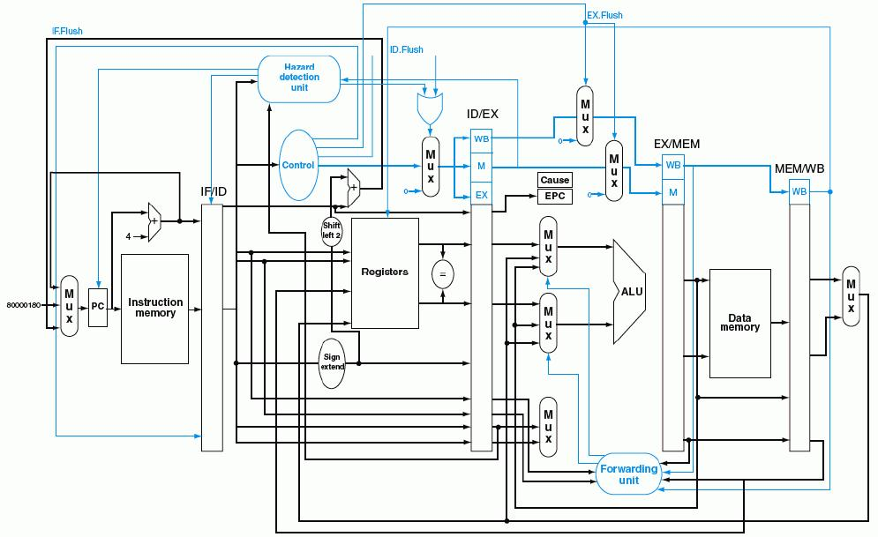
带异常处理的流水线数据通路
Overflow
80000180H

Slide 57
流水线方式下的异常处理的难点问题
流水线中同时有5条指令，到底是哪一条发生异常？
根据异常发生的流水段可确定是哪条指令，因为各类异常发生的流水段不同
“溢出”在EXE段检出
“无效指令”在ID段检出
“除数为0”在ID段检出
“无效指令地址”在IF段检出
“无效数据地址”在Load/Store指令的EXE段检出
外部中断与特定指令无关，如何确定处理点？
可在IF段或WB段中进行中断查询，需要保证当前WB段的指令能正确完成，并在有中断发生时，确保下个时钟开始执行中断服务程序
检测到异常时，指令已经取出多条，当前PC的值已不是断点，怎么办？
指令地址存放在流水段R，可把这个地址送到EPC保存，以实现精确中断
非精确中断不能提供准确的断点，而由操作系统来确定哪条指令发生了异常
一个时钟周期内可能有多个异常或中断，该先处理哪个？
异常：检出异常后，其原因存到专门寄存器中并流到最后阶段处理，使前面指令的异常优先级高于后面指令
中断：在中断查询程序或中断优先级排队电路中按顺序查询
系统中只有一个EPC，多个中断发生时，一个EPC不够放多个断点，怎么办？
总是把优先级最高的送到EPC中
在异常处理过程中，又发生了新的异常或中断，怎么办？
利用中断屏蔽和中断嵌套机制来处理
后面三个问题中有关中断的问题在第八章中详细介绍！

Slide 58
三种处理器实现方式的比较
单周期、多周期、流水线三种方式的执行时间比较。
假设各主要功能单元的操作时间为：
存储单元：200ps
ALU和加法器：100ps
寄存器堆（读 / 写）：50ps
假设MUX、控制单元、PC、扩展器和传输线路都没有延迟。
程序中各类指令占比为：25%取数、10%存数、52%ALU、11%分支、2%跳转
下面实现方式中，哪个更快？快多少？
（1）单周期：每条指令在一个固定长度的时钟周期内完成
（2）多周期：每类指令时钟数为取数-5，存数-4，ALU-4，分支-3，跳转-3
（3）流水线：每条指令分取指令、取数/译码、执行、存储器存取、写回五阶段
（假定没有结构冒险，数据冒险采用转发处理，分支延迟槽为1，预测准确率
为75%；不考虑异常、中断和访存缺失引起的流水线冒险）

Slide 59
解：CPU执行时间 = 指令条数 x CPI x 时钟周期长度
三种方式指令条数都一样，所以只要比较CPI和时钟周期长度即可。
各指令类型要求的时间长度为：

Slide 60
对于单周期方式：
时钟周期将由最长指令来决定，应该是load指令，为600ps
所以，N条指令的执行时间为600N(ps)
对于多周期方式：
时钟周期将取功能部件最长所需时间，应该是存取操作，为200ps
根据各类指令的频度，计算平均时钟周期数为：
CPU时钟周期=5x25%+4x10%+4x52%+3x11%+3x2%=4.12
所以， N条指令的执行时间为4.12x200xN=824N(ps)
对于流水线方式：
Load指令：当发生Load-use依赖时，执行时间为2个时钟，否则1个时钟，
故平均执行时间为1.5个时钟；
Store、ALU指令：1个时钟；
Branch指令：预测成功时，1个时钟，预测错误时，2个时钟，
所以：平均约为：.75x1+.25x2=1.25个；
Jump指令：2个时钟（总要等到译码阶段结束才能得到转移地址）
平均CPI为：1.5x25%+1x10%+1x52%+1.25x11%+2x2%=1.17
所以， N条指令的执行时间为1.17x200xN=234N(ps)

Slide 61
第二讲小结
流水线冒险的几种类型：
资源冲突、数据相关、控制相关（改变指令流的执行方向）
数据冒险的现象和对策
数据冒险的种类
相关的数据是ALU结果，可以通过转发解决
相关的数据是DM读出的内容，随后的指令被阻塞一个时钟
数据冒险和转发
转发检测 / 转发控制
数据冒险和阻塞
阻塞检测 / 阻塞控制
控制冒险的现象和对策
静态分支预测技术
缩短分支延迟技术
动态分支预测技术
异常和中断是一种特殊的控制冒险

Slide 62
第三讲 高级流水线技术
高性能流水线 - 指令级并行(ILP)技术
超流水线
多发射流水线
静态多发射
编译器静态推测完成“指令打包”和“冒险处理”
MIPS 2-发射流水线数据通路
循环展开指令调度
IA-64的EPIC技术
动态多发射
动态多发射流水线的通用模型
动态多发射流水线的执行模式
按序发射、按序完成
按序发射、乱序完成
乱序发射、乱序完成

Slide 63
提高性能措施—实现指令级并行
N段流水线说明一个时钟周期内最多有几条指令同时并行执行？
实现指令流内部的并行流水线称为指令级并行（ILP）
有两种指令级并行策略:
超流水线（Super- pipelining）
级数更多的流水线
理想情况下，流水线的加速比与流水段的数目成正比。
（即：理想情况下，流水段越多，时钟周期越短，指令吞吐率越高。）
但是，它会增加开销，且是有极限的！
多发射流水线（Multiple issue pipelining ）
多条指令(如整数运算、浮点运算、装入/存储等) 同时启动并独立运行
前提：有多个执行部件。如：定点、浮点、乘/除、取数/存数部件等
结果：能达到小于1的CPI
（例如：理想的四路多发射流水线的IPC为4）
需要实现以下两个主要任务
指令打包：分析每个周期发射多少条？哪些指令可以同时发射？
冒险处理：由编译器静态调整指令或在运行时由硬件处理
实现上述两个主要任务的基础—推测技术
两种实现方法
静态多发射：由编译器在编译时静态完成指令打包和冒险处理
动态多发射：由硬件在执行时动态完成指令打包和冒险处理
N条！故N越大并行度越高！
CPI =？
CPI =1
增加的开销体现在哪里？
流水段寄存器！
怎样来突破极限呢？
一条流水线变成多条流水线！
IPC:定义为CPI的倒数
Notes:
ILP: Instruction Level Parallelism

Slide 64
实现多发射技术的基础—推测技术
推测技术：由编译器或处理器猜测指令执行结果，并以此来调整指令执行顺序，使指令的执行能达到最大可能的并行。
指令打包的决策依赖于“推测”的结果
可根据指令间的相关性来进行推测
与前面指令不相关的指令可以提前执行
可对分支指令进行推测
可提前执行分支目标处的指令
推测只是“猜测”，可能推测错误，故需有推测错误检测和回滚机制。
推测错误时会增加额外开销
有“软件推测”和“硬件推测”两种
软件推测：编译器通过推测来静态重排指令（一定要正确！）
硬件推测：处理器在运行时通过推测来动态调度指令

Slide 65
静态多发射处理器
由编译器在编译时进行相关性分析和静态分支预测，静态完成“指令打包”和“冒险处理”。
指令打包（将同时发射的多条指令合并成一个长指令）
将同一个时钟周期内发射的多个指令看成是一条多个操作的长指令，把它称为一个“发射包”。
“静态多发射”也被称为“超长指令字”（VLIW-Very Long Instruction Word），采用这种技术的处理器被称为VLIW处理器。
在同一个周期内发射的指令类型是受限制的(如洗衣店的干洗/水洗）
例如，只能是一条ALU指令/分支指令与一条Load/Store指令
IA-64采用这种方法，Intel称其为EPIC（Explicitly Parallel Instruction Computer—显式并行指令计算机）。
冒险处理（主要是数据冒险和控制冒险）
做法1：完全由编译器通过代码调度和插入nop指令来消除所有冒险，无需硬件实现冒险检测和流水线阻塞—由编译器处理。
做法2：由编译器通过静态分支预测和代码调度来消除同时发射指令间内部依赖，由硬件检测数据冒险并进行流水线阻塞。
即：保证打包指令内部不会出现冒险！

Slide 66
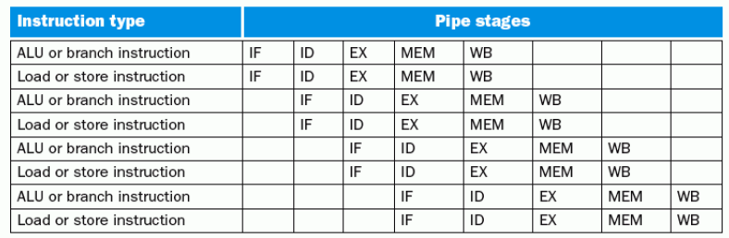
静态多发射处理器实例
实例：MIPS ISA 指令集的静态多发射----2发射处理器
要使原MIPS处理器能够同时处理两条流水线，数据通路需要做哪些改进？
1. 同时要能取并译码两条指令，怎么办？
将两条指令打包成64位长指令，前面为ALU/Branch，后面为lw/sw
没有配对指令时，就用nop指令代替
将64位长指令中的两个操作码同时送到控制器（指令译码器）进行译码
2. 两条指令同时要读两个寄存器或写寄存器（和lw配对时） ，怎么办？
增加两个读口和一个写口
3. 两条指令同时要使用ALU进行运算 ，怎么办？
增加一个ALU（包括2组输入总线和1组输出总线）

Slide 67
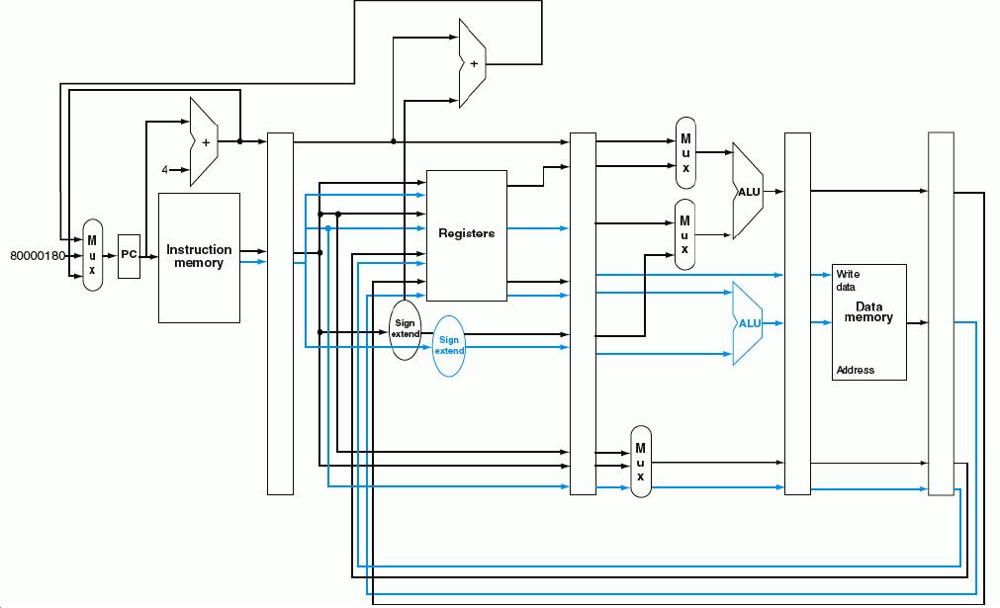
2发射流水线数据通路（蓝色是增加部分）
需增加额外加法器或ALU
ALU/分支指令在ALU运算时，
Load/Store指令要计算地址
指令成对放在64位对齐内存区域，前面是ALU/分支指令。若不能成对，则用nop代替缺失指令，每次取两条指令，同时对两条指令译码
控制器和控制信号会要求数据通路怎样改呢？
流水段寄存器要增宽，控制信号分别传送。
同时需为ALU和lw/sw指令读寄存器，同时需为ALU运算和Load结果写寄存器

Slide 68
2发射流水线的特点
优点：潜在性能将提高大约2倍 （实际上达不到！为什么？ ）
缺点：
为消除结构冒险，需增加额外部件。
增加了潜在的由于数据冒险和控制冒险导致的性能损失
例1：对于Load-use数据冒险
单发射流水线：只有一条指令延迟
2发射流水线：有一个周期（即2条指令）延迟
例2：对于ALU-Load/Store数据冒险
单发射流水线：可用“转发”技术使ALU结果直接转发到Load/Store指令的EXE阶段
2发射流水线：两条指令同时进行，ALU的结果不能直接转发，因而不能提供给与其配对的Load/Store指令使用，只能延迟一个周期。
为更有效地利用多发射处理器的并行性，必须有更强大的编译器，能够充分消除指令间的依赖关系，使指令序列达到最大的并行性！

Slide 69
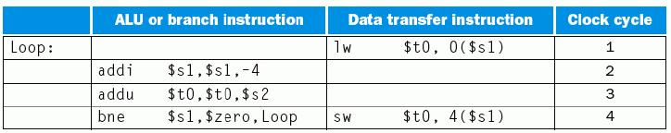
例：2发射MIPS指令调度
前三条和后两条各具有相关性,可把第四条指令调到第一条后面。
sw指令是否有问题？怎么办？
以下是一段循环代码段
Loop: lw $t0, 0($s1)
addu $t0, $t0, $s2
sw $t0, 0($s1)
addi $s1, $s1, -4
bne $s1, $zero, Loop
(能看出这段程序的功能吗？)
为了能在2发射MIPS流水线中有效执行，该怎样重新排列指令
调度方案如下：没有指令配对时，用nop指令代替
$s1减4，故sw指令偏移改为4
能否把addi和lw配成一对？
好像是可以？
寄存器$s1被同时读，后由sw写，两条指令的操作不会相互影响。
循环内进行的是数组访问！
nop
addi $s1, $s1, -4 ？
nop
nop
一个循环内，五条指令在四个时钟内完成，实际CPI为0.8，即: IPC=1.25
在循环中访问数组的更好的调度技术是“循环展开”

Slide 70
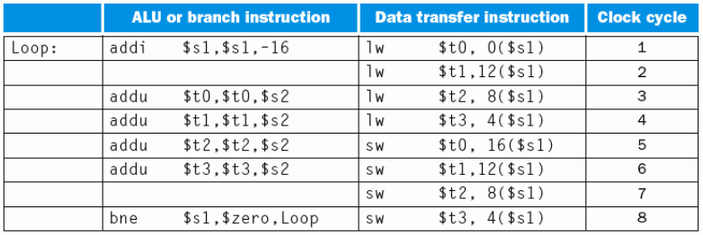
用“循环展开”技术进行指令调度
基本思想：展开循环体，生成多个副本，在展开的指令中统筹调度。
上例采用“循环展开”后的指令序列是什么？
为简化起见，假定循环执行次数是4的倍数
指令最佳调度序列如下：
*为何第1条指令将$s1减16？
*为何第1条lw与对应的sw的偏移不同，但其他几条lw和sw却相同？
*为何多了3个寄存器$t1、$t2、$t3？
使用了“重命名寄存器”技术，多用了这三个临时寄存器，消除了名字依赖关系（非真实依赖，只是寄存器名相同而已）。
代价:
多用了三个临时寄存器，并增加了代码大小（存储空间变大）
好处：充分利用并行，并消除部分循环分支！

Slide 71
循环展开后的偏移量分析
第一条指令将$s1减16，指令执行后，$s1的值变成了4次循环结束时$s1的值
所以循环体内各数组元素的访问指令的偏移量依次为：
16 - 数组元素1，12 - 数组元素2 ，8 - 数组元3，4 - 数组元素4
为什么第一个周期中的lw指令的偏移量为0?
新的$S1
因为第一个周期中的lw指令进行地址计算时，addi指令的执行结果还没有写到$s1中，所以，此时$s1中还是原来的值。
$s1-16
数组元素4
数组元素3
为什么第一条addu指令不放在第二周期?
为了避免与第1条lw指令发生load-use冒险！
数组元素2
当循环次数不是4的倍数时这样做就有问题！
处理办法：对多出来的不足4次的循环另外进行处理。
数组元素1
$s1
执行1遍展开指令即是原4次循环，指令lw, addu, sw各有4条，共12条，再加1条addi和1条bne，总共14条指令。
14条指令用了8个时钟，CPI达到8/14=0.57。
可见：编译器和机器结构密切相关！系统程序员必须非常了解机器结构！编译器的好坏直接影响程序执行快慢！

Slide 72
实例：Intel IA-64架构
IA-64类似于64位MIPS架构，是Register-Register型的RISC风格指令集
但有独特性：要求编译器显式地给出指令级的并行性，Intel称其为EPIC
—显式并行指令计算机
EPIC的实现技术
指令组（Instruction Group）：相互间没有寄存器级数据依赖的指令序列
指令组长度任意，用“停止标记”在指令组之间明显标识
指令组内部的所有指令可并行执行，只要有足够硬件且无内存操作依赖。
指令包：同时发射的指令重新编码并形成指令包
长度为128，由5位长的模板字段、三个41位长的指令组成
模板字段对应于以下五类功能部件中的三条指令
整数ALU、非整数ALU（移位和多媒体）、访存、浮点、分支
IA-64是采用静态3-发射流水线，实现机制比较复杂，对编译器的要求极高。
Intel试图让IA-64架构脱离IA-32 CISC架构的束缚，但由于其复杂和与IA-32不兼容，因此没有得到市场认可，后推出了Intel64架构。
Notes:
AMD公司在2003年推出了兼容IA-32的64位版本指令集x86-64，后来更名位AMD64。Intel后来推出了与AMD64兼容的Intel64架构。

Slide 73
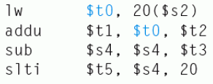
动态多发射处理器
由硬件在执行时动态完成指令打包和冒险处理
通常被称为超标量处理器（Superscalar）
同一个时钟动态发射多条指令，一个周期内可执行一条以上指令
与VLIW处理器的不同点：
VLIW处理器：与机器结构密切相关，在结构有差异的机器上要重新编译
超标量处理器：编译器仅进行指令顺序调整（还是串行序列），不进行指令打包，由硬件根据机器结构决定同时发射哪几条指令。编译后的代码能够被不同结构的机器正确执行
超标量处理器结合动态流水线调度（Dynamic pipeline scheduling）技术
通过指令相关性检测和动态分支预测等手段，投机性地不按指令顺序执行，当发生流水线阻塞时，可以到后面找指令来执行。这种指令执行方式 称为乱序执行(out-of-order execution)。
例如，下面的指令序列中，哪条指令可以提前执行？
sub指令可提前到addu指令前执行
如果不将sub调到前面，则会影响slti指令的执行，而且还会发生load-use冒险。

Slide 74
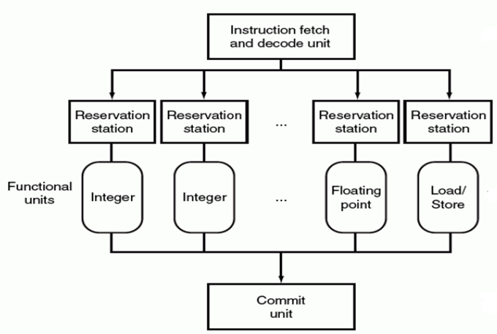
动态流水线调度的通用模型
要实现动态流水线调度，处理器需提供必要的机制和相应的处理部件。
动态流水线调度的通用模型：
一个指令预取和译码单元：按序或无序发射
多个并列执行的功能单元：乱序执行
一个提交单元：按序提交
每个功能单元有各自的保留站
用于保存操作数和操作命令
功能单元，用于完成指令的具体功能
提交单元缓存所有已完成的指令结果，直到该结果能安全写回到寄存器或存储器，也称为Reorder Buffer
指令的结果也可在Reorder Buffer中被“转发”

Slide 75
动态流水线的几种执行模式
根据动态流水线指令发射和完成顺序，可分为三种执行模式：
按序发射按序完成（Pentium）
按序发射无序完成（Pentium II和Pentium III）
无序发射无序完成（Pentium 4）
最保守的是按序完成，它的好处：
简化异常检测及其处理
能在被推测指令完成前得知推测结果的正确性
动态流水线调度的必要性
编译器可依据数据依赖关系调度代码，为什么还要超标量处理器来动态调度？
并不是所有阻塞都能事先确定，动态调度可在阻塞时，提前执行无关指令
例如，Cache缺失是不可预见的阻塞
动态分支预测需要根据执行的真实情况进行预测
采用动态调度使得硬件将处理器细节屏蔽起来，软件发行商无需针对同一指令集的不同处理器发行相应的编译器，并且，以前的代码也可在新的处理器上运行，无需重新编译。

Slide 76
本讲小结
有以下两种指令级并行(ILP)技术（即：高性能流水线形式）
超流水线：更多的流水线级数
多发射流水线：同时发射多个指令，有多条流水线同时进行
静态多发射（VLIW处理器+编译器静态调度）
动态多发射（超标量处理器+动态流水线调度）
静态多发射（VLIW（超长指令字）处理器）
由编译器静态推测来完成“指令打包”和“冒险处理”
MIPS 2-发射Datapath中有2个执行部件，将2条指令打包，并同时译码执行
采用循环展开进行指令调度，能得到很好的性能
IA-64采用VLIW技术，Intel称其为EPIC技术，3条指令打包
动态多发射（超标量处理器）
指令执行时由硬件动态推测，多个执行部件，同时发射多个指令到执行部件
3种动态多发射流水线的执行模式
按序发射按序完成、按序发射无序完成、无序发射无序完成

Slide 77
本章总结1
指令流水线的设计
将每条指令的执行规整化为若干个同样的流水阶段
每个流水阶段的执行时间一样，都等于一个时钟
理想情况下，每个时钟有一条指令进入流水线，也有一条指令执行结束
每个流水段中的部件都是组合逻辑加寄存器，组合逻辑中产生的结果在时钟到来时被存储到寄存器（如：程序计数器、条件码寄存器、流水线寄存器等）。
每两个相邻流水段之间的流水线寄存器，用以记录所有在后面阶段要用到的各种信息，有哪些呢？
控制信号、指令的代码、参加运算的操作数、指令运算结果、指令异常信息、寄存器读口地址、寄存器写口地址、存储器地址、PC+4、本条指令地址等。
指令译码得到的控制信号通过流水线寄存器传送到后面各个流水段中

Slide 78
本章总结2
单周期, 多周期 和 流水线比较
Cycle 1
Cycle 2
Clk
Single Cycle Implementation:
Load
Store
Waste
Cycle 1
Cycle 2
Cycle 3
Cycle 4
Cycle 5
Cycle 6
Cycle 7
Cycle 8
Cycle 9
Cycle 10
Clk
Multiple Cycle Implementation:
Load
Store
R-type
Ifetch
Reg
Exec
Mem
Wr
Ifetch
Reg
Exec
Mem
Ifetch
Pipeline Implementation:
Load
Ifetch
Reg
Exec
Mem
Wr
Store
Ifetch
Reg
Exec
Mem
Wr
R-type
Ifetch
Reg
Exec
Mem
Wr
Notes:
Here are the timing diagrams showing the differences between the single cycle, multiple cycle, and pipeline implementations.
For example, in the pipeline implementation, we can finish executing the Load, Store, and R-type instruction sequence in seven cycles.
In the multiple clock cycle implementation, however, we cannot start executing the store until Cycle 6 because we must wait for the load instruction to complete.
Similarly, we cannot start the execution of the R-type instruction until the store instruction has completed its execution in Cycle 9.
In the Single Cycle implementation, the cycle time is set to accommodate the longest instruction, the Load instruction.
Consequently, the cycle time for the Single Cycle implementation can be five times longer than the multiple cycle implementation.
But may be more importantly, since the cycle time has to be long enough for the load instruction, it is too long for the store instruction so the last part of the cycle here is wasted.

Slide 79
本章总结3
指令流水线的局限性
并不是每条指令都有相同多个流水段
并不是每个流水段都一样长
随着流水线深度的增加，流水线寄存器的额外开销比例也增大
指令在资源冲突、数据相关或控制相关时会发生流水线冒险
指令流水线的执行效率
吞吐率：比非流水线方式下大大提高
指令执行时间：相对于非流水线方式，一条指令的执行时间延长了
结构冒险（资源冲突）：多条指令同时使用同一个功能部件
规定每个功能部件在一条指令中只能被用一次
规定每个功能部件只能在某个特定的阶段被用
指令存储器(Code Cache)和数据存储器(Data Cache)分开

Slide 80
本章总结4
数据冒险（数据相关）：前面指令的结果是后面指令的操作数
软件阻塞：（如：编译器）在后面的数据相关指令前插入nop指令
硬件阻塞：在后面数据相关指令的特定流水段插入“气泡”以“阻塞”指令继续执行，直到取得所需数据为止
“转发”（旁路）：把前面指令执行过程中得到的数据直接传送到后面指令相应的流水段中。
对于load-use，采用“阻塞加转发”的方式解决数据冒险
提高流水线指令效率的高级流水线技术
超流水线：级数更多的流水线
多发射流水线：同时发射多条指令的流水线
静态多发射：VLIW结构、编译器静态推测
动态多发射：超标量结构、硬件动态推测调度

Slide 81
本章总结5
控制冒险（控制相关）：返回指令、分支指令等可能改变顺序增量的PC值，由于获取转移目标地址的时间较长，使得在目标地址产生前已经有指令被取到流水线中，如果已经取出执行的指令不是正确的指令，则发生控制冒险。
软件阻塞：（如：编译器）在控制相关指令后面插入nop指令
硬件阻塞：在控制相关指令后面的指令被取出前插入“气泡”，使流水线停顿若干时钟，直到控制相关指令得到正确的PC值为止
采用“分支预测”技术。简单（静态）地预测每次分支结果都一样，或根据分支指令执行历史进行动态预测，动态预测能达到90%以上的成功率
采用延迟分支技术。将前面一条与分支指令无关的指令放到分支指令后面执行，这样，流水线不会发生阻塞现象。这种对指令顺序进行调整的工作在程序编译阶段完成

Slide 82
作业
P203 6, 7, 8, 9, 10, 11, 12

